Slide 1
Uber and Lyft in Boston, MA Price Analysis and Prediction
Course Name: Cloud Computing
Group 1
Final Project
Monday 6:10 pm – 8:40 pm
Aaron Yang

Slide 2
Contents
Scope of the project
Features to be Implemented
Data Sources & Expected Outcomes
Logical Architecture
Data Flow
Cloud services in action(S3, Glue, QuickSight, SageMaker, RDS)
(Main Part Compared with Part A)

Slide 3
Scope
The objective of this project is to analyze and predict ride-sharing prices for Uber and Lyft in Boston, Massachusetts. The project will focus on exploring the patterns in pricing, identifying key factors that influence price fluctuations, and building a predictive model to forecast future ride prices for both services.

Slide 4
Features to be Implemented
Data Collection & Cleaning
(price per ride, distance)
Exploratory Data Analysis (EDA)
(price trends over time, location, weather)
Feature Engineering
(ride distance, surge pricing)
Price Prediction Model
Model Evaluation

Slide 5
Logical Architecture
Amazon S3: Store raw ride data, weather data, and processed datasets.
AWS Glue: Clean and preprocess the ride and weather data, including feature extraction and integration.
Amazon SageMaker: Train and deploy machine learning models to predict ride prices based on the processed data.
Amazon RDS: Store the predictions and analysis results in a relational database for easy querying and visualization.
Amazon QuickSight: Create dashboards and reports to visualize the findings, such as price trends and model performance.

Slide 6
Data Resource & Expected Outcome
Dataset Overview:
Dataset downloaded from Kaggle.
Dataset Size:
693071 Observations
57 Variables
Expected Outcome:
Price prediction model
Insights on factors affecting prices

Slide 7
Data Flow
Data Ingestion: Ride data is ingested from public datasets or APIs and stored in Amazon S3.
Data Cleanup: AWS Glue processes the raw data to handle missing values, extract features, and join it with weather data.
Visualization: The insights and predictions are visualized using Amazon QuickSight, where users can interact with the data to explore price trends and factors.
Model Training: The cleaned data is used to train machine learning models in Amazon SageMaker.
Model Evaluation: The model is evaluated using validation sets and the results are stored in Amazon RDS.

Slide 8




Part 1 – Data STORAGE

Slide 9
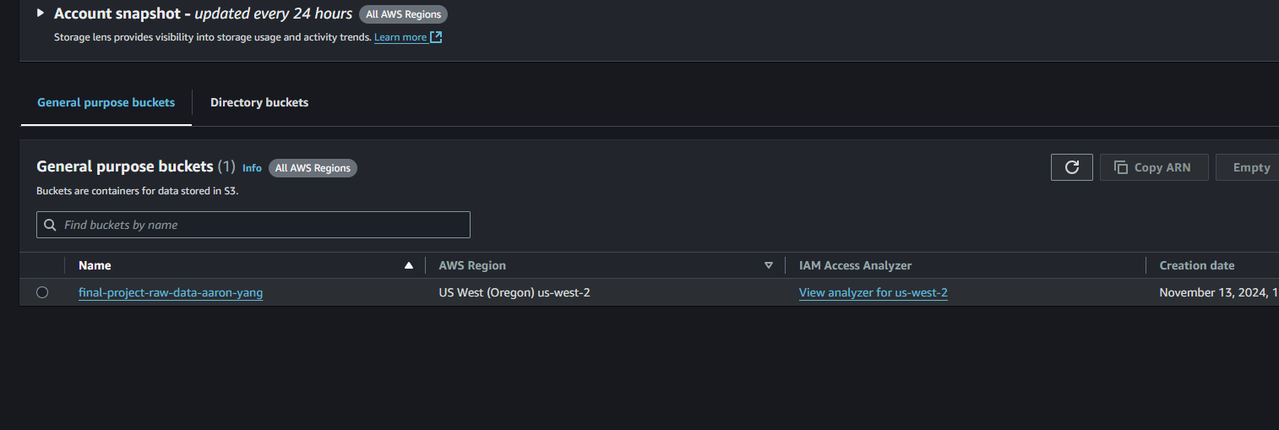
Part 1 – Data Storage
S3 bucket named as final-project-raw-data-aaron-yang
1.1 Create Amazon S3

Slide 10
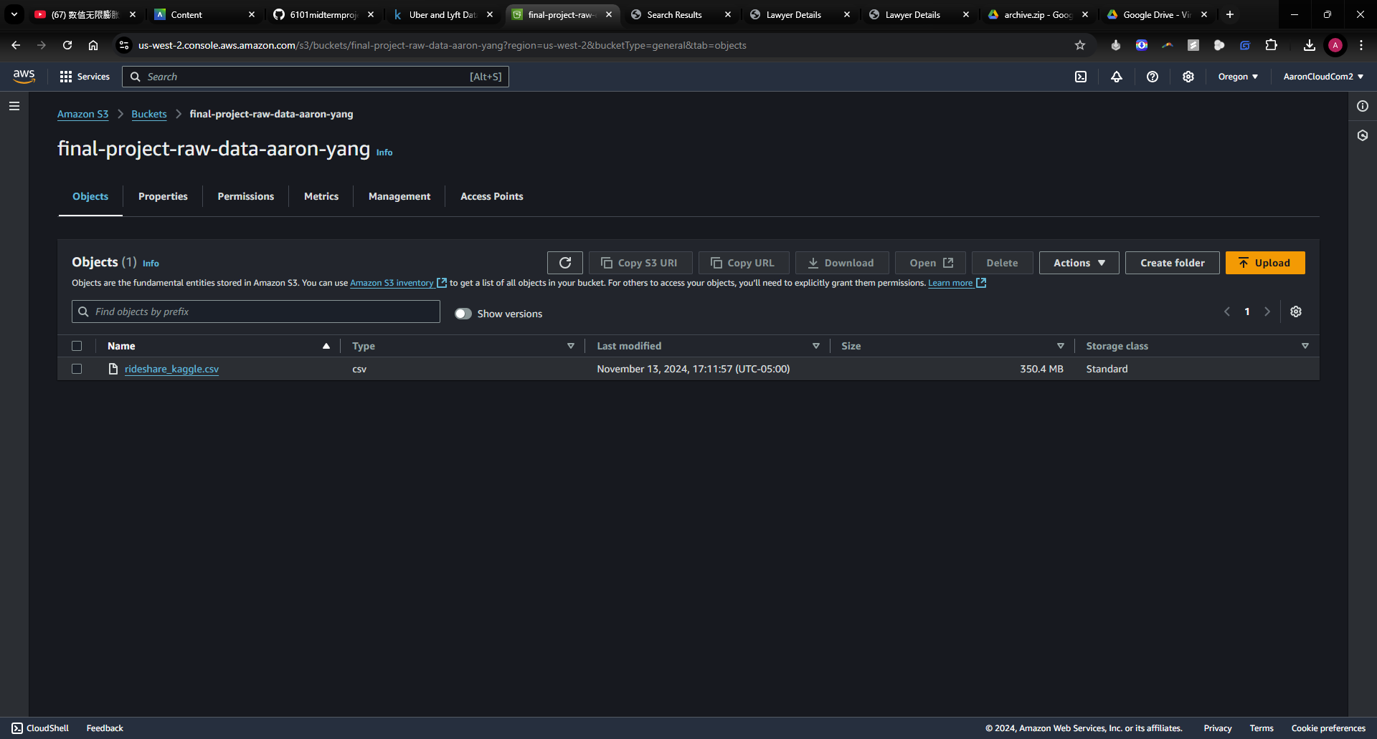
Part 1 – Data Storage
1.2 Upload dataset into Amazon S3

Slide 11
Part 2 – Data Cleaning

Slide 12
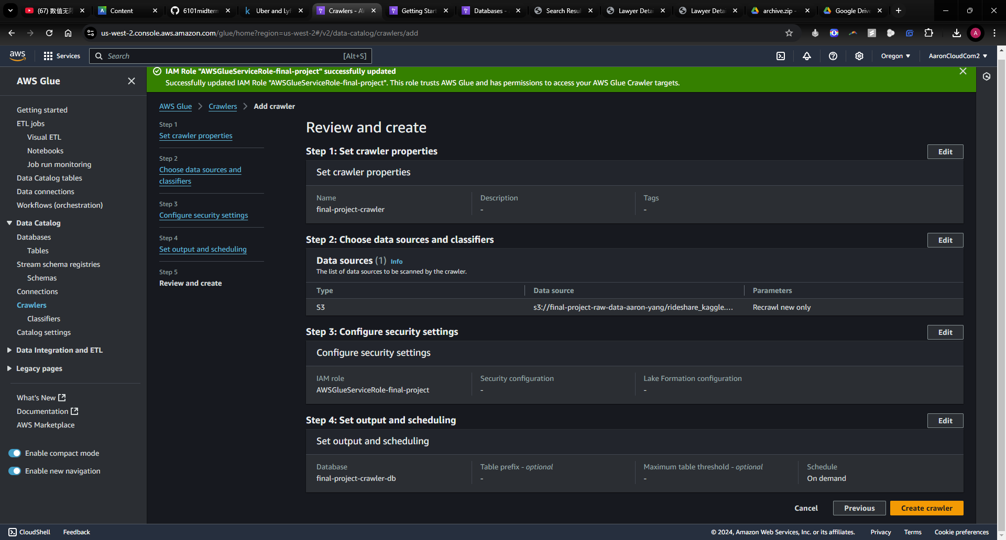
Part 2 – Data Cleaning
2.1 Crawler Setup

Slide 13
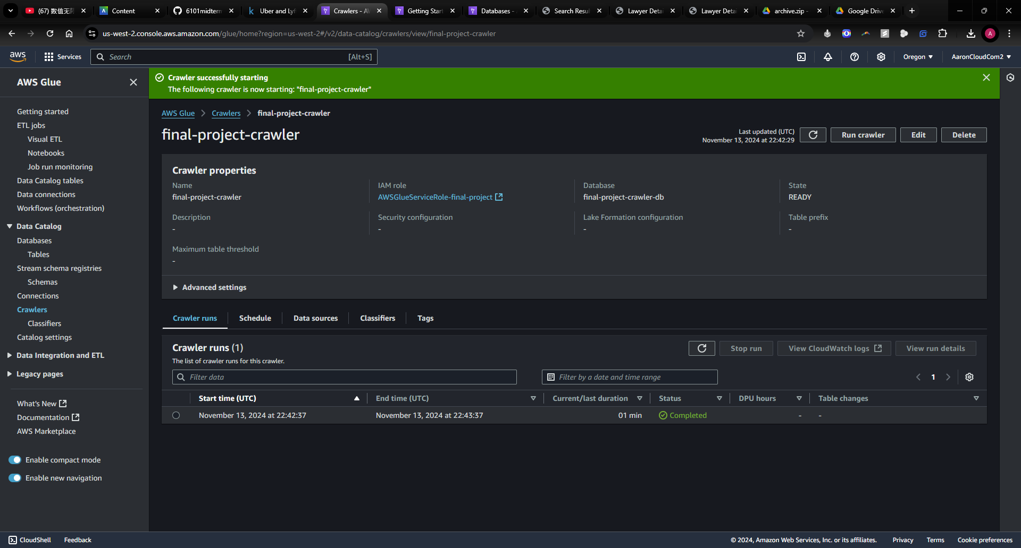
Part 2 – Data Cleaning
2.1 Crawler Setup

Slide 14
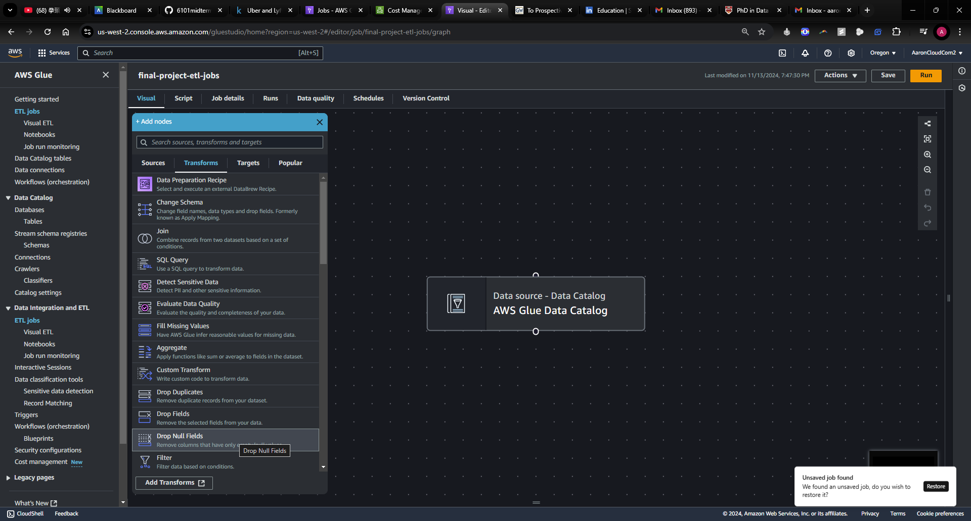
Part 2 – Data Cleaning
2.2 Create Jobs

Slide 15
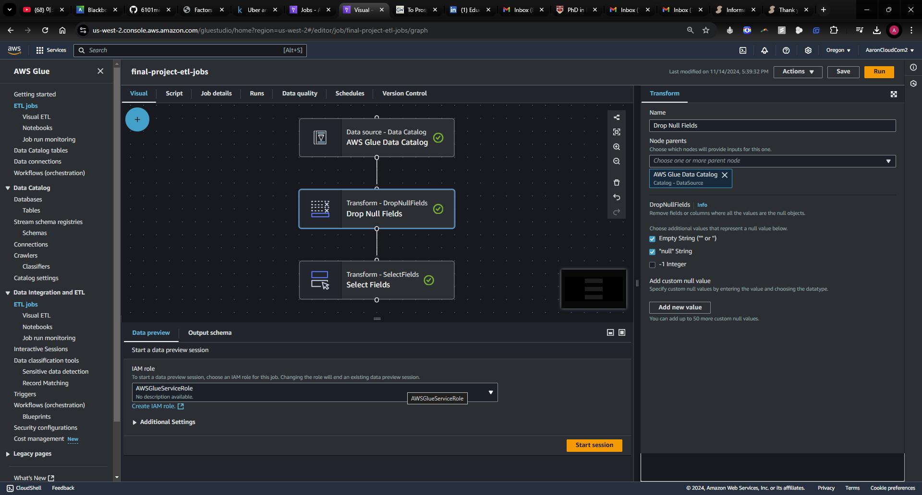
Part 2 – Data Cleaning
2.3 Data Cleaning with Glue
2.3.1 Drop Null Values and Empty String

Slide 16
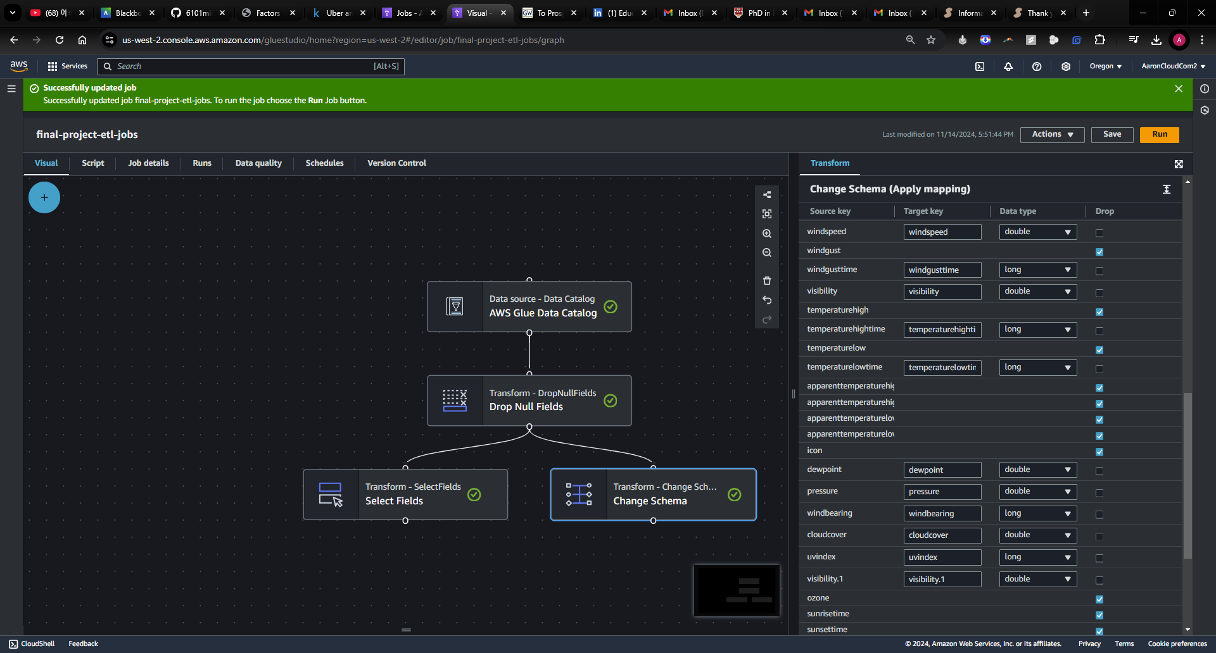
Part 2 – Data Cleaning
2.3 Data Cleaning with Glue
2.3.2 Select Features with Domain Knowledge

Slide 17
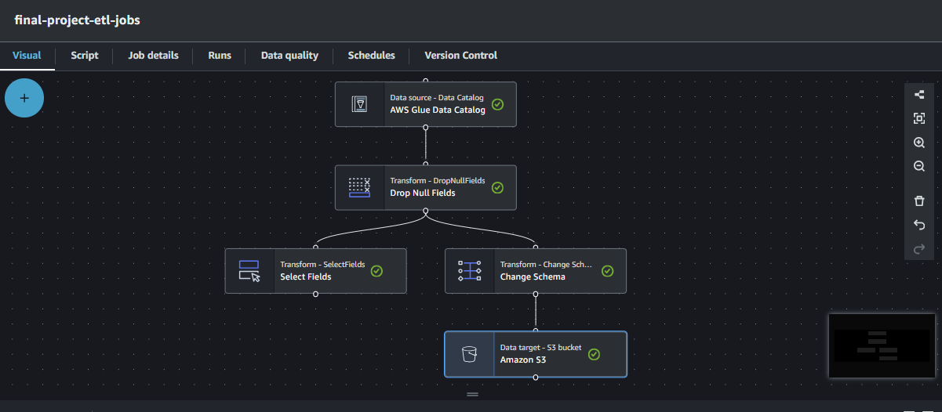
Part 2 – Data Cleaning
2.3 Data Cleaning with Glue
2.3.3 Set up the S3 Target

Slide 18
Part 3 – Data Visualization

Slide 19
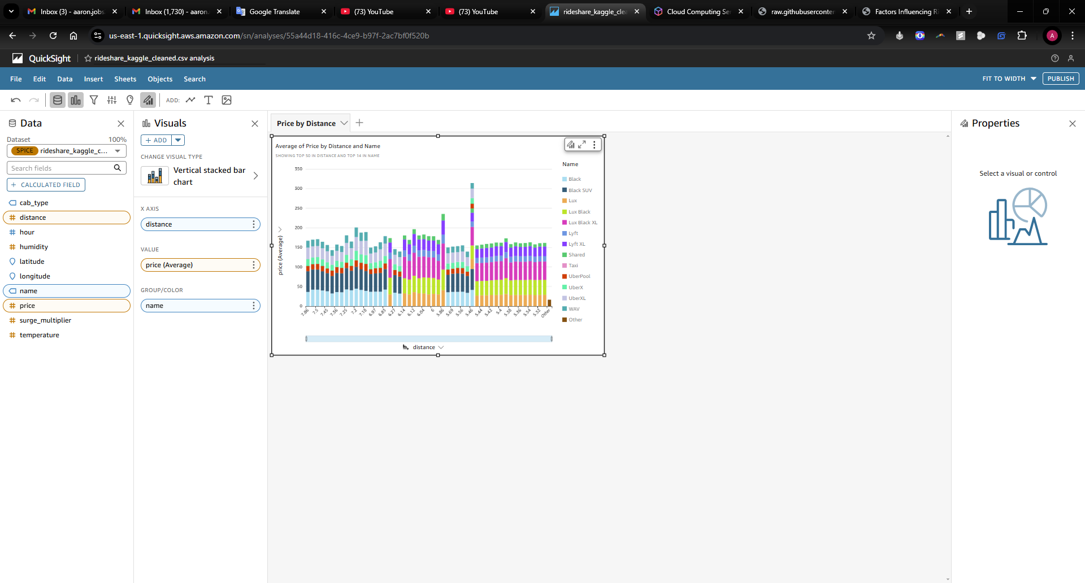
Part 3 – Data Visualization
There is a potential relationship between cab type and price.
3.1 Price by Cab Type

Slide 20
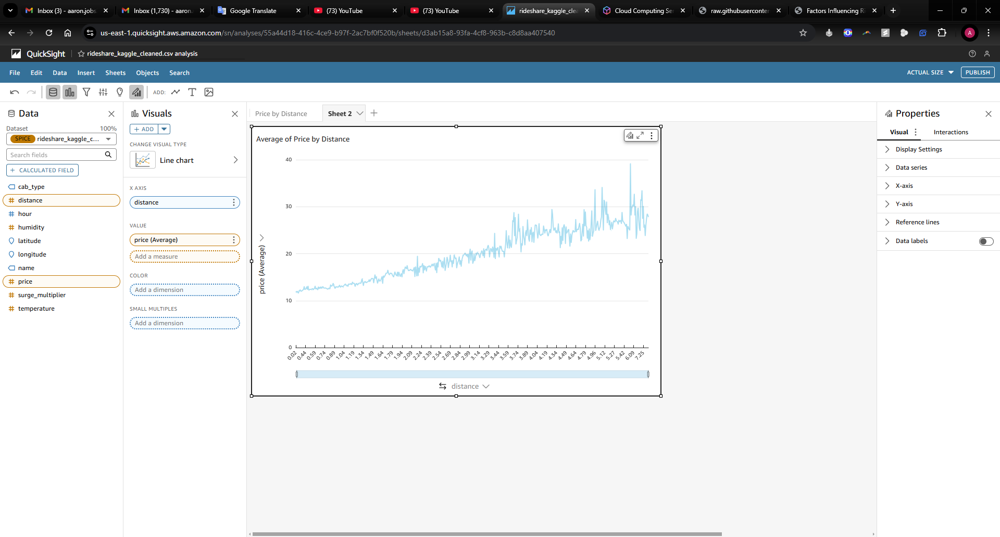
Part 3 – Data Visualization
There is a positive correlation between distance and price, indicating that as the distance increases, the price tends to rise correspondingly.
3.2 Price by Distance

Slide 21
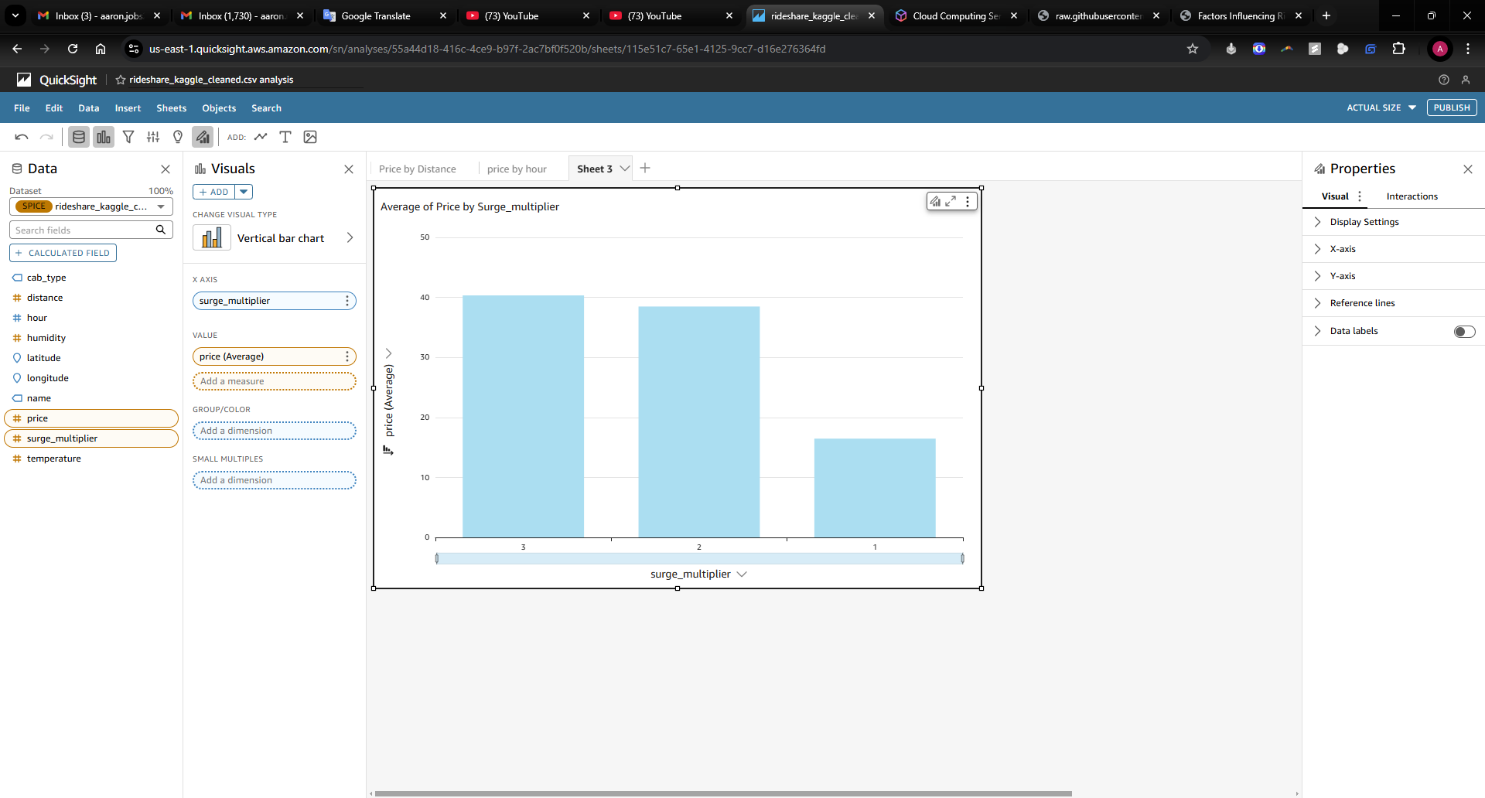
Part 3 – Data Visualization
There is a potential relationship between surge_multipler and price.
3.3 Price by surge_multipler

Slide 22
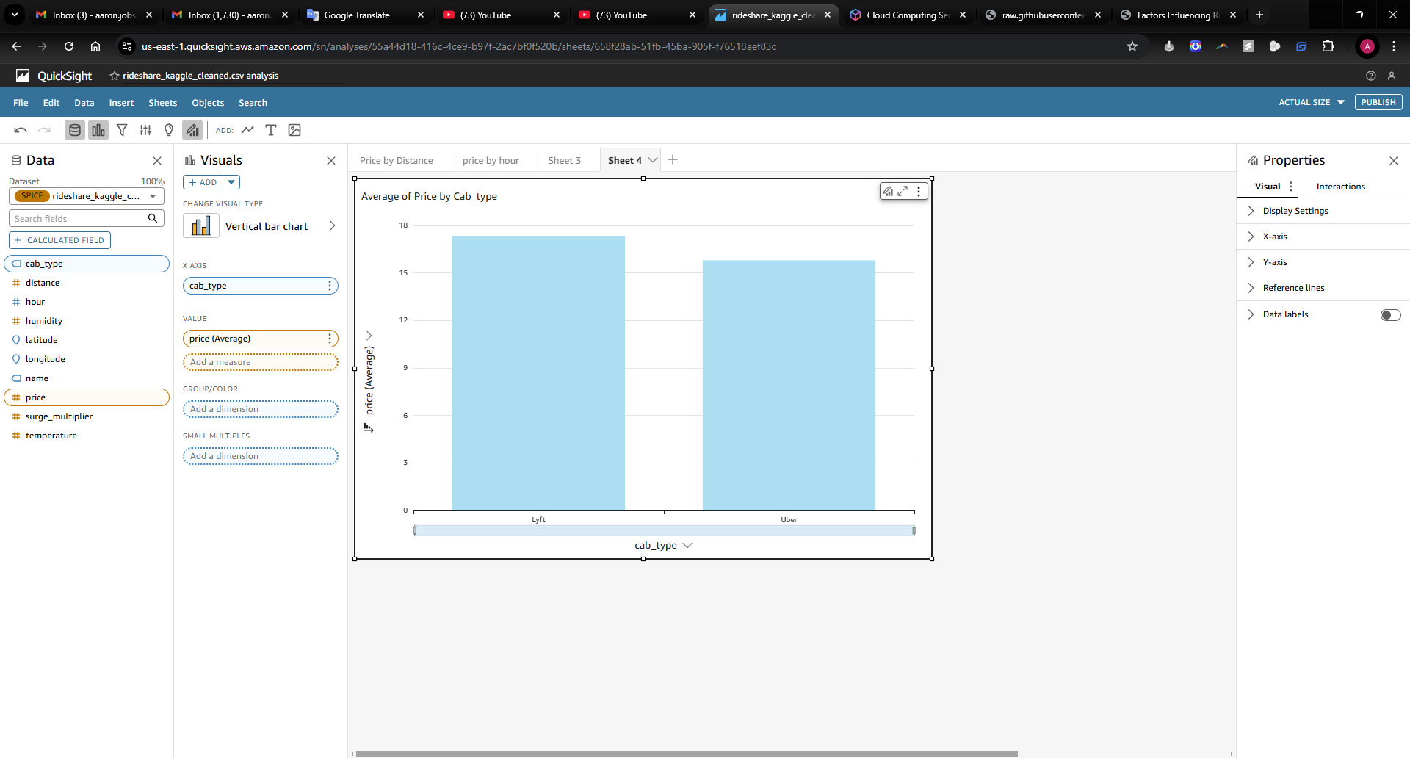
Part 3 – Data Visualization
There is a potential relationship between company and price. The price of Lyft is a little more than Uber.
3.4 Price by Company

Slide 23
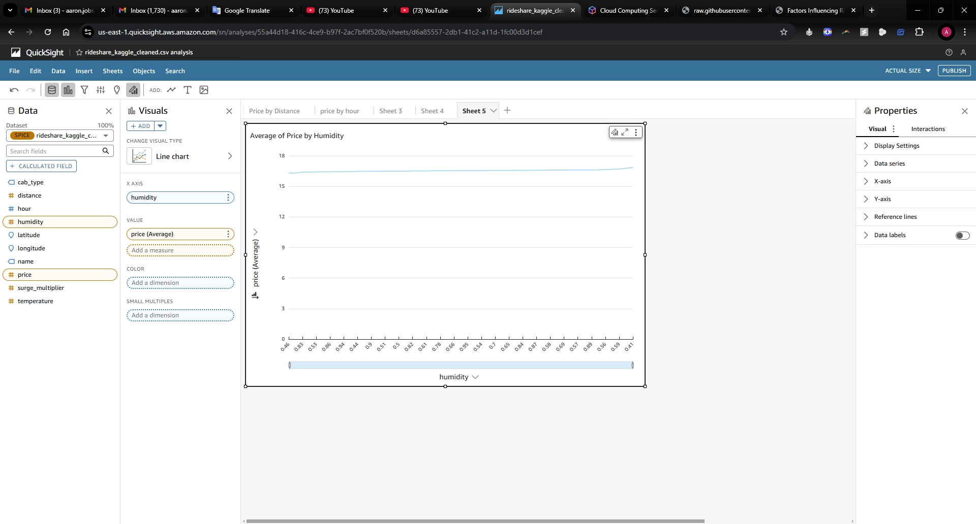
Part 3 – Data Visualization
There is no potential relationship between humidity and price.
3.5 Price by Humidity

Slide 24
Part 4 – Model Training

Slide 25
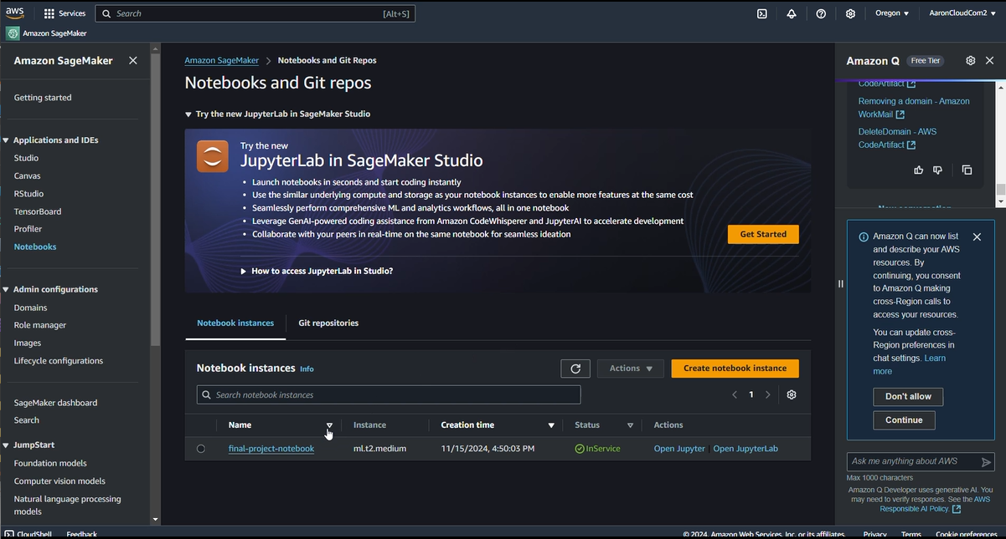
Part 4 – Model TRaining
SageMaker and Notebook on AWS

Slide 26
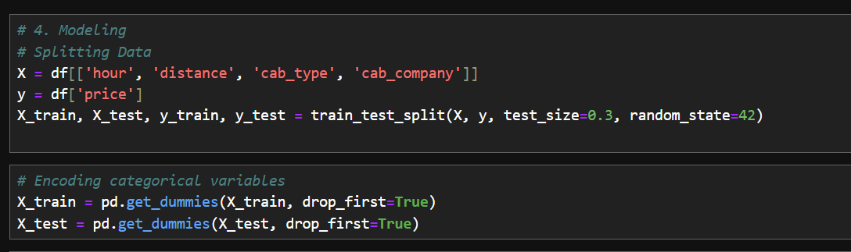
Part 4 – Model TRaining
Select Features and Splitting Data

Slide 27



Part 4 – Model TRaining
The Decision Tree model demonstrated the best performance in terms of predictive accuracy, capturing non-linear relationships in the data effectively.
Model Evaluation

Slide 28

Part 5 – Storing Results

Slide 29
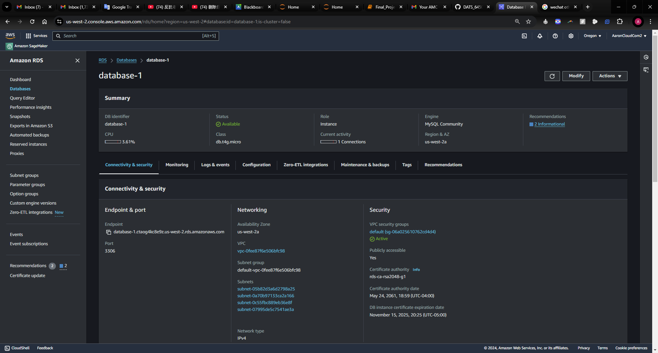
Part 5 – Storing Results
RDS Creation

Slide 30
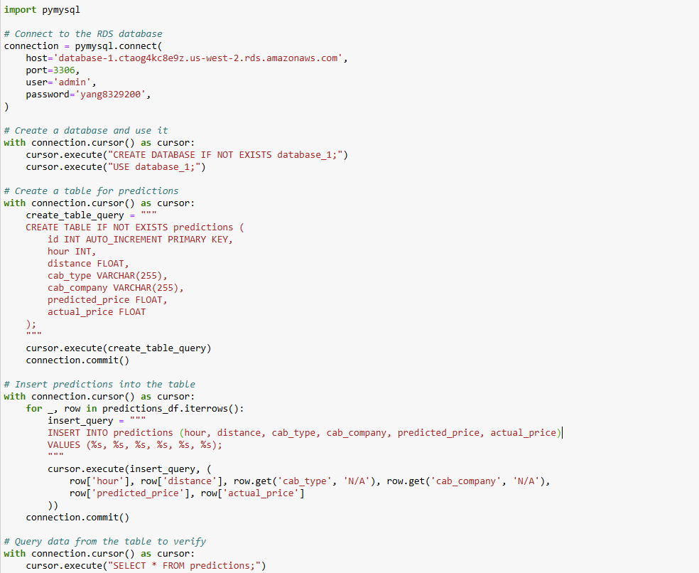
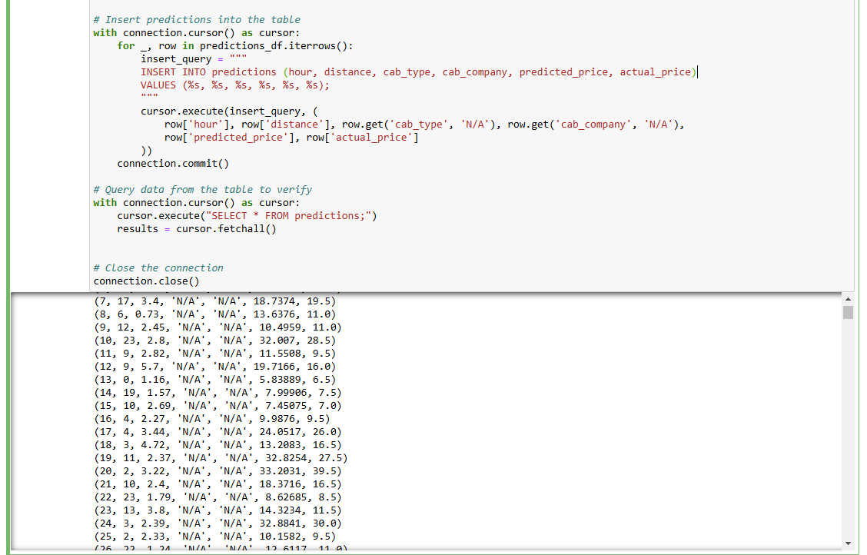
Part 5 – Storing Results
RDS Connected with Python

Slide 31
Part 6 – Summary

Slide 32
Part 6 – SUMMARY
This project provides valuable insights for both ride-sharing companies and consumers while leveraging AWS’s robust cloud infrastructure for seamless data handling and analysis.
AWS Services Utilized:
Amazon S3: Scalable storage for raw and processed data.
AWS Glue: Data preprocessing, feature extraction, and integration.
Amazon SageMaker: Model training and deployment.
Amazon RDS: Storage for prediction results and analysis outputs.
Amazon QuickSight: Interactive dashboards for visualizing pricing trends and model performance.

Slide 33
Thank you!
Aaron Yang

